Slide 1
Computer Networks(2015 Pattern) Unit VI – Application Layer
Note: Material for this presentations are taken from Internet and books and only being used for student reference

Slide 2
Outline
Hyper Text Transfer Protocol (HTTP),
Email: SMTP, MIME, POP3, Webmail,
TELNET,
Dynamic Host Control Protocol (DHCP),
Simple Network Management Protocol (SNMP).
FTP,
Domain Name System (DNS),

Slide 3
Web and HTTP
First some jargon
Web page consists of objects
Object can be HTML file, JPEG image, Java applet, audio file,…
Web page consists of base HTML-file which includes several referenced objects
Each object is addressable by a URL
Example URL:
www.someschool.edu/someDept/pic.gif
host name
path name

Slide 4
HTTP overview
HTTP: hypertext transfer protocol
Web’s application layer protocol
client/server model
client: browser that requests, receives, “displays” Web objects
server: Web server sends objects in response to requests
HTTP uses port no 80
HTTP request
PC running
Explorer
HTTP response
HTTP request
Server
running
Apache Web
server
HTTP response
Mac running
Navigator

Slide 5
HTTP overview (continued)
Uses TCP:
client initiates TCP connection (creates socket) to server, port 80
server accepts TCP connection from client
HTTP messages (application-layer protocol messages) exchanged between browser (HTTP client) and Web server (HTTP server)
TCP connection closed
HTTP is “stateless”
server maintains no information about past client requests

Slide 6
HTTP connections
Nonpersistent HTTP
At most one object is sent over a TCP connection.
New connection must be established and maintained for each requested object
requires 2 RTTs per object
OS overhead for each TCP connection
Persistent HTTP
Multiple objects can be sent over single TCP connection between client and server.
server leaves connection open after sending response
subsequent HTTP messages between same client/server sent over open connection
client sends requests as soon as it encounters a referenced object
as little as one RTT for all the referenced objects

Slide 7
Nonpersistent HTTP
Suppose user enters URL(contains text, references to 10 jpeg images)
1a. HTTP client initiates TCP connection to HTTP server
1b. HTTP server waiting for TCP connection at port 80. “accepts” connection, notifying client
2. HTTP client sends HTTP request message into TCP connection socket. Message indicates that client wants object.
3. HTTP server receives request message, forms response message containing requested object, and sends message into its socket
time

Slide 8
Nonpersistent HTTP (cont.)
4. HTTP server closes TCP connection.
5. HTTP client receives response message containing html file, displays html. Parsing html file, finds 10 referenced jpeg objects
time
6. Steps 1-4 repeated for each of 10 jpeg objects

Slide 9
Non-Persistent HTTP: Response time
Definition of RTT(Round Trip Time): time for a small packet to travel from client to server and back.
Response time:
one RTT to initiate TCP connection
one RTT for HTTP request
file transmission time
total = 2RTT+transmit time
initiate TCP
connection
RTT
request
file
RTT
time to
transmit
file
file
received
time
time

Slide 10
HTTP Message Formats
Two types of message
HTTP Request message
HTTP Response Message

Slide 11
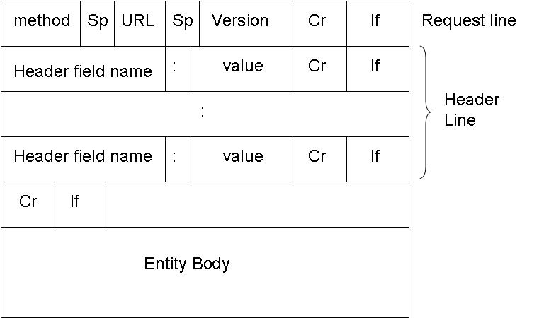
HTTP request message

Slide 12
HTTP request message Example
HTTP request message:
ASCII (human-readable format)
request line
(GET, POST,
HEAD commands)
GET /somedir/page.html HTTP/1.1
Host: www.someschool.edu
User-agent: Mozilla/4.0
Connection: close
Accept-language:fr
(extra carriage return, line feed)
header
lines
Carriage return,
line feed
indicates end
of message

Slide 13
Uploading form input
Post method:
Web page often includes form input
Input is uploaded to server in entity body
GET method:
Uses GET method
Input is uploaded in URL field of request line:
Example www.somesite.com/animalsearch?monkeys&banana

Slide 14
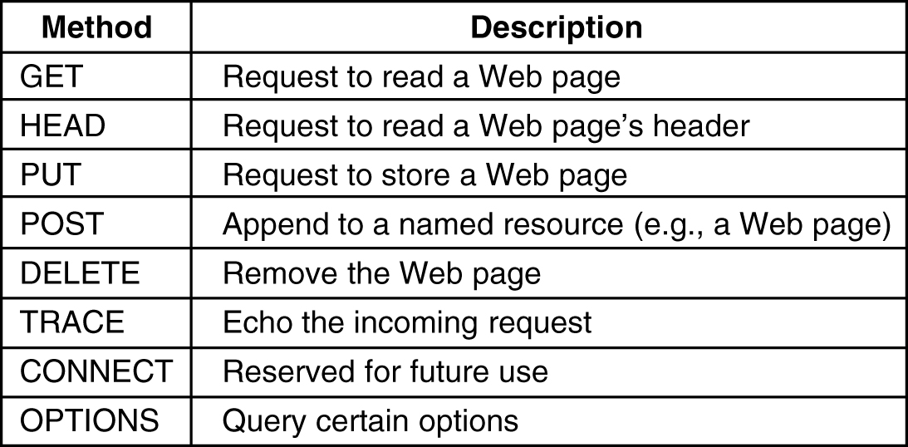
HTTP Methods
The GET method requests the server to send the page . The page is suitably encoded in MIME. The vast majority of the requests on the web are GETs.
GET filename HTTP/1.1
Where filename is the resource name to be fetched and 1.1 is the protocol version being used
The HEAD method just asks for the message header, without the actual page. This method can be used to get a page’s time of last modification, to collect information for indexing purposes, or just to test an URL for validity
The PUT method is the reverse of GET. Instead of reading a page, it writes a page. This method makes it possible to build a collection of web pages on a remote web server. The body of the request contains the page. It may be encoded using MIME, in which case, the lines following the PUT might include Content-Type and authentication headers to prove that the caller indeed has permission to perform the operation
POST is similar to PUT. It too, bears an URL, but instead of replacing the existing data, it appends it to any existing data. Posting a message to a newsgroup or adding a file to a bulletin board are example of the usage.
DELETE does what you expect: deletes a page from a remote web server; authentication and permissions play a major role here. There is no guarantee that a DELETE operation is successful since even if the remote web server is willing to delete a page, the file permissions may be set in such a way that the server process doesn’t have rights to do it.
TRACE method is used for debugging. It instructs the server to send back the request. This is useful when requests are not processed correctly and the client wants to know it sent the proper request.
CONNECT – is not used at the moment
OPTIONS – provides a way for the client to query the server about its properties or those of a specified file
Notes:
The GET method requests the server to send the page . The page is suitably encoded in MIME. The vast majority of the requests on the web are GETs.
GET filename HTTP/1.1
Where filename is the resource name to be fetched and 1.1 is the protocol version being used
The HEAD method just asks for the message header, without the actual page. This method can be used to get a page’s time of last modification, to collect information for indexing purposes, or just to test an URL for validity
The PUT method is the reverse of GET. Instead of reading a page, it writes a page. This method makes it possible to build a collection of web pages on a remote web server. The body of the request contains the page. It may be encoded using MIME, in which case, the lines following the PUT might include Content-Type and authentication headers to prove that the caller indeed has permission to perform the operation
POST is similar to PUT. It too, bears an URL, but instead of replacing the existing data, it appends it to any existing data. Posting a message to a newsgroup or adding a file to a bulletin board are example of the usage.
DELETE does what you expect: deletes a page from a remote web server; authentication and permissions play a major role here. There is no guarantee that a DELETE operation is successful since even if the remote web server is willing to delete a page, the file permissions may be set in such a way that the server process doesn’t have rights to do it.
TRACE method is used for debugging. It instructs the server to send back the request. This is useful when requests are not processed correctly and the client wants to know it sent the proper request.
CONNECT – is not used at the moment
OPTIONS – provides a way for the client to query the server about its properties or those of a specified file

Slide 15
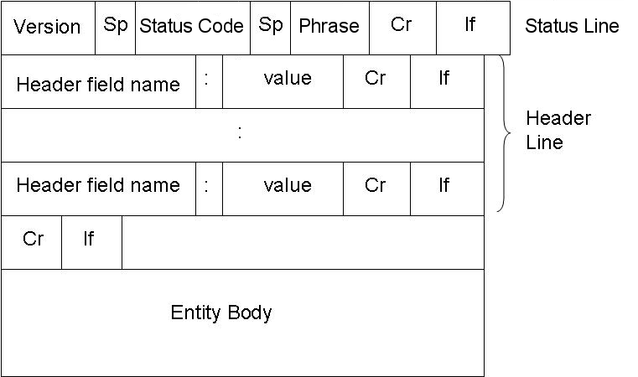
HTTP response message

Slide 16
HTTP response message example
status line
(protocol
status code
status phrase)
HTTP/1.1 200 OK
Connection close
Date: Thu, 06 Aug 1998 12:00:15 GMT
Server: Apache/1.3.0 (Unix)
Last-Modified: Mon, 22 Jun 1998 …...
Content-Length: 6821
Content-Type: text/html
data data data data data ...
header
lines
data, e.g.,
requested
HTML file

Slide 17
HTTP Version differences
HTTP/1.0
Have only 16 status codes
Provides only basic authentication
Uses Non persistent connection
RTT is more so bandwidth waste is vast
Stateless
Supports only GET POST and HEAD method
HTTP/1.1
Have introduced new 24 status code
Provides strong authentication
Uses Persistent connection
RTT is less so bandwidth utilization is good
Uses cookies as state management mechanism
Supports GET, POST, HEAD,PUT and DELETE

Slide 18

Web caches (proxy server)
Goal: satisfy client request without involving origin server
user sets browser: Web accesses via cache
browser sends all HTTP requests to cache
object in cache: cache returns object
else cache requests object from origin server, then returns object to client
origin
server
Proxy
server
HTTP request
HTTP request
client
HTTP response
HTTP response
HTTP request
HTTP response
client
origin
server

Slide 19
Outline
Hyper Text Transfer Protocol (HTTP),
Email: SMTP, MIME, POP3, Webmail,
TELNET,
Dynamic Host Control Protocol (DHCP),
Simple Network Management Protocol (SNMP).
FTP,
Domain Name System (DNS),

Slide 20
FTP (File Transfer Protocol)
Objective
Allow file sharing between remote machine
Transfer data reliably and efficiently
FTP Protocol falls within client server model
Both client & server have 2 process allowing information (Data & command) to be managed , they are
DTP(Data transfer Process)
PI(Protocol Interpreter)

Slide 21
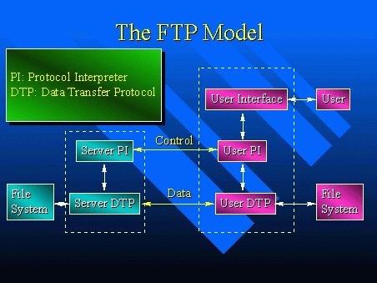
FTP model/connection

Slide 22
FTP: the file transfer protocol
During FTP Connection 2 transmission channels are open
Control Channel (For command)
Data Channel (For data)
Control uses port no 21
Data connection uses Port no 20

Slide 23
FTP: separate control, data connections
TCP control connection
port 21
FTP
client
TCP data connection
port 20
FTP
server
FTP client contacts FTP server at port 21
client authorized over control connection
client browses remote directory by sending commands over control connection.
when server receives file transfer command, server opens 2nd TCP connection (for file) to client
after transferring one file, server closes data connection.
FTP server maintains “state”: current directory, earlier authentication

Slide 24
FTP transmission modes
Stream mode: Data is sent as a continuous stream, relieving FTP from doing any processing. Rather, all processing is left up to TCP. No End-of-file indicator is needed, unless the data is divided into records.
Block mode: FTP breaks the data into several blocks (block header, byte count, and data field) and then passes it on to TCP.
Compressed mode: Data is compressed using a simple algorithm (usually run-length encoding).

Slide 25
FTP commands, responses
Sample commands:
sent as ASCII text over control channel
USER username
PASS password
LIST return list of file in current directory
RETR filename retrieves (gets) file
STOR filename stores (puts) file onto remote host
Sample return codes
status code and phrase (as in HTTP)
331 Username OK, password required
125 data connection already open; transfer starting
425 Can’t open data connection
452 Error writing file

Slide 26
Comparison between HTTP and FTP
HTTP uses TCP
Only one TCP connection between client and server
Send its control information in-band
HTTP is stateless
Port No is 80
FTP uses TCP
Two parallel TCP connection, one for data and one for control
Send its control information out-of-band
FTP maintains State
Port no is 20 and 21

Slide 27
Question Time!
What is meant by Anonymous FTP?

Slide 28
Outline
Hyper Text Transfer Protocol (HTTP),
Email: SMTP, MIME, POP3, Webmail,
TELNET,
Dynamic Host Control Protocol (DHCP),
Simple Network Management Protocol (SNMP).
FTP,
Domain Name System (DNS),

Slide 29
What is SMTP?
The standard for e-mail transmissions across the Internet
It is defined in RFC 821
It is a relatively simple, text-based protocol
Port No is 25
It uses reliable connection to send mail. For the same it uses TCP connection.

Slide 30
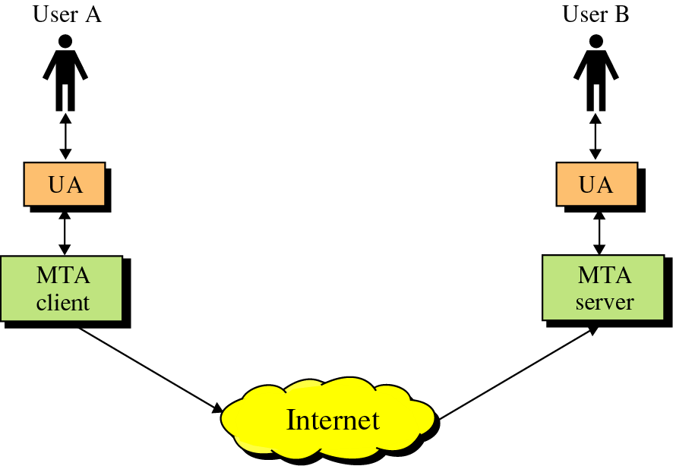
SMTP
SMTP clients and servers have two main components
User Agents – Prepares the message, encloses it in an envelope.
Mail Transfer Agent (MTA) – Transfers the mail across the internet
User Agent
Mail Transfer Agents

Slide 31
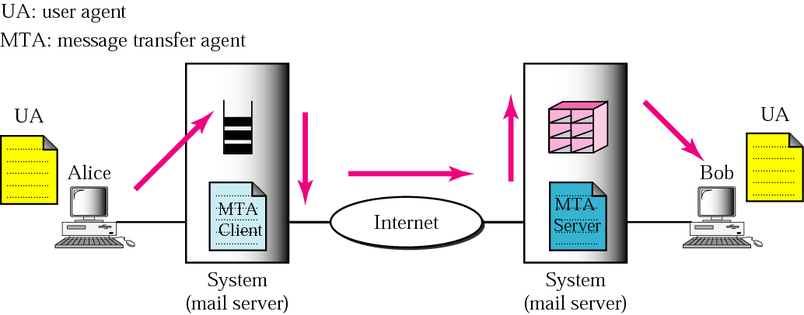
SMTP Working with UA and MTA

Slide 32
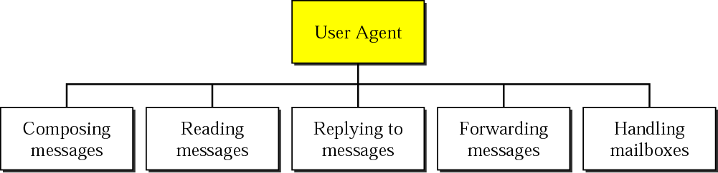
USER AGENT
The user agent (UA) provides service to the user to make the process of sending and receiving a message easier.

Slide 33
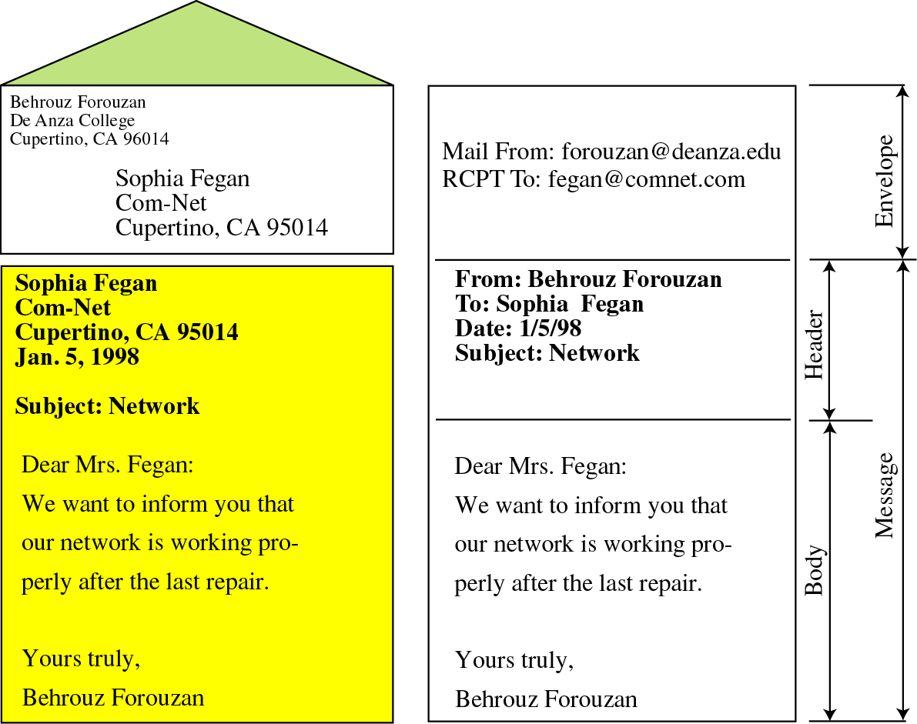
What is Mail?
Mail is a text file
Envelope –
sender address
receiver address
other information
Message –
Mail Header – defines the sender, the receiver, the subject of the message, and some other information
Mail Body – Contains the actual information in the message

Slide 34
MESSAGE TRANSFER AGENT: SMTP
The actual mail transfer requires message transfer agents (MTAs). The protocol that defines the MTA client and server in the Internet is called Simple Mail Transfer Protocol (SMTP).

Slide 35
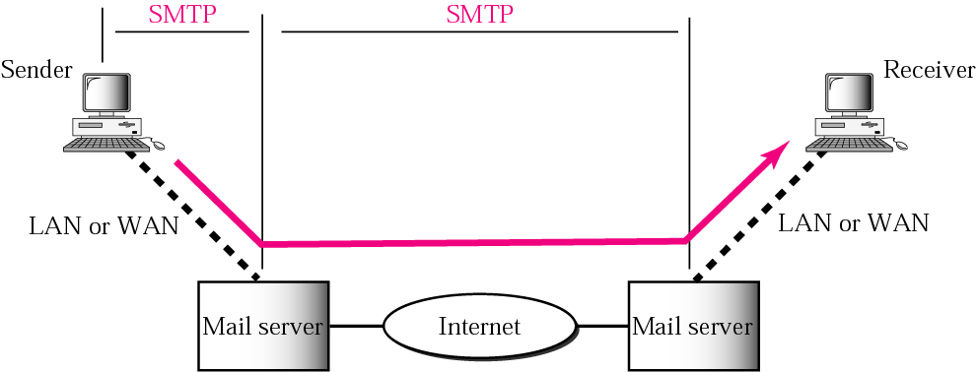
Figure SMTP range

Slide 36
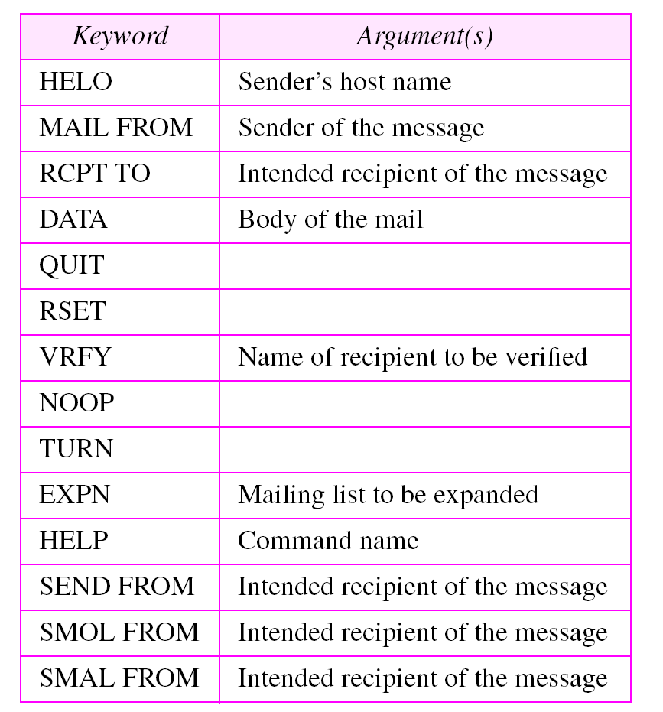
Table 20.4 Commands

Slide 37
Status Codes
The Server responds with a 3 digit code that may be followed by text info
2## - Success
3## - Command can be accepted with more information
4## - Command was rejected, but error condition is temporary
5## - Command rejected, Bad User!

Slide 38
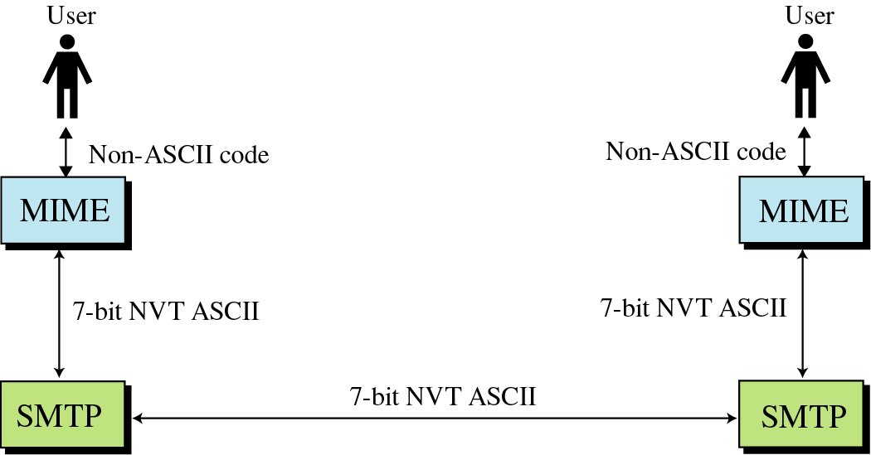
Extensions to SMTP
MIME – Multipurpose Internet Mail Extensions
Transforms non-ASCII data to NVT (Network Virtual Terminal) ASCII data
Text
Application
Image
Audio
Video

Slide 39
MIME and Base64 Encoding
If the internet is the information highway, then the path for email is a narrow tunnel
Only very small vehicles can pass trough
Then how do you send a big truck through a small ravine?
You have to break it down to smaller pieces and transport the pieces through the ravine, and reassemble the truck

Slide 40
MIME and Base64 Encoding
The same happens when you send a file attachment via email.
This is known as encoding
the binary data (256 bits) is transformed to ASCII text (128 bits
allowing it to fit through the tunnel
On the recipient's end, the data is decoded and the original file is rebuilt.

Slide 41
MESSAGE ACCESS AGENT: POP AND IMAP
The third stage of mail delivery uses a message access agent; the client must pull messages from the server. Currently two message access protocols are available: Post Office Protocol, version 3 (POP3) and Internet Mail Access Protocol, version 4.
The topics discussed in this section include:
POP3
IMAP4

Slide 42
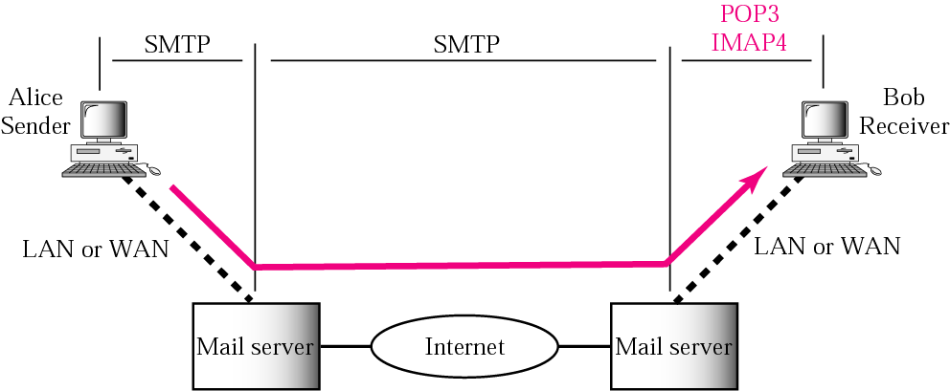
Figure POP3 and IMAP4

Slide 43
POP3
Starts when the user starts the mail reader
Mail reader calls up the ISP (if there is no connection) and establishes a TCP connection with the message transfer agent on port 110;
Authorization
Having user logged in by sending its username and password
Transactions
User collecting the e-mails and marking them for deletion
Update
Causes the e-mails to be deleted

Slide 44
IMAP
POP3 works fine for users with one e-mail account with one ISP, accessed from one PC
If mail was accessed from different locations, user may loose e-mails, security issues may appear, etc
An alternative final delivery protocol, IMAP (Internet Message Access Protocol), defined in RFC2060
Instead assuming that all messages will be downloaded and work offline after that (like POP3), IMAP assumes that all e-mail will remain on the server indefinite in multiple mailboxes
Provides extensive mechanisms to read messages or parts of messages, mechanisms to create, destroy and manipulate multiple mailboxes.

Slide 45
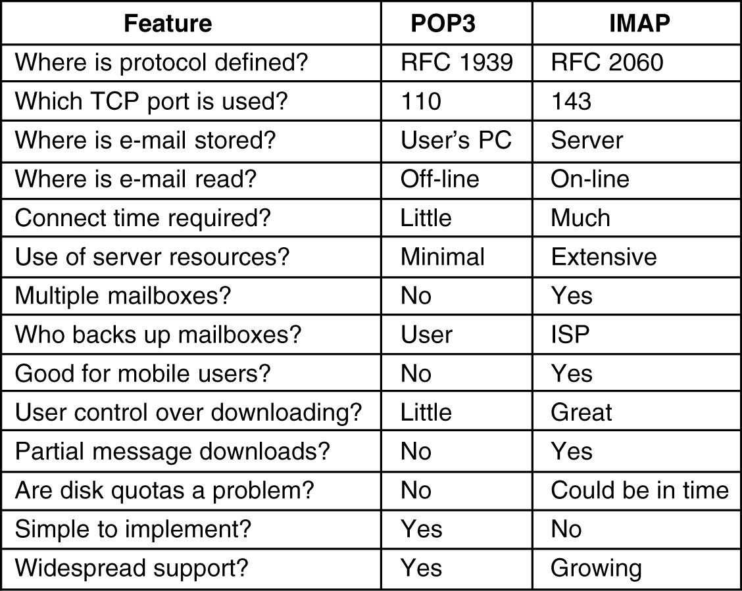
POP3 vs. IMAP

Slide 46
Outline
Hyper Text Transfer Protocol (HTTP),
Email: SMTP, MIME, POP3, Webmail,
TELNET,
Dynamic Host Control Protocol (DHCP),
Simple Network Management Protocol (SNMP).
FTP,
Domain Name System (DNS),

Slide 47
DNS (Domain Name System)Basic
IP addresses are difficult to remember
Need some mechanisms to translate gmail.com to the IP address.
To solve this problem DNS was invented
DNS is a hierarchical, domain-based naming scheme and a distributed database system for implementing this naming scheme
Usage: Map URL name into an IP address

Slide 48
DNS: Domain Name System Basic:
Maps URL to IP address and vice versa
Runs over UDP and TCP
Uses port No 53
Application layer protocol

Slide 49
DNS : DNS services
hostname to IP address translation
host aliasing
Canonical, alias names
mail server aliasing
load distribution
replicated Web servers: set of IP addresses for one canonical name

Slide 50
DNS components
Name space
Name Servers
Resolver

Slide 51
The Name Space
The name space is the structure of the DNS database
An inverted tree with the root node at the top
Each node has a label
The root node has a null label, written as “”

Slide 52
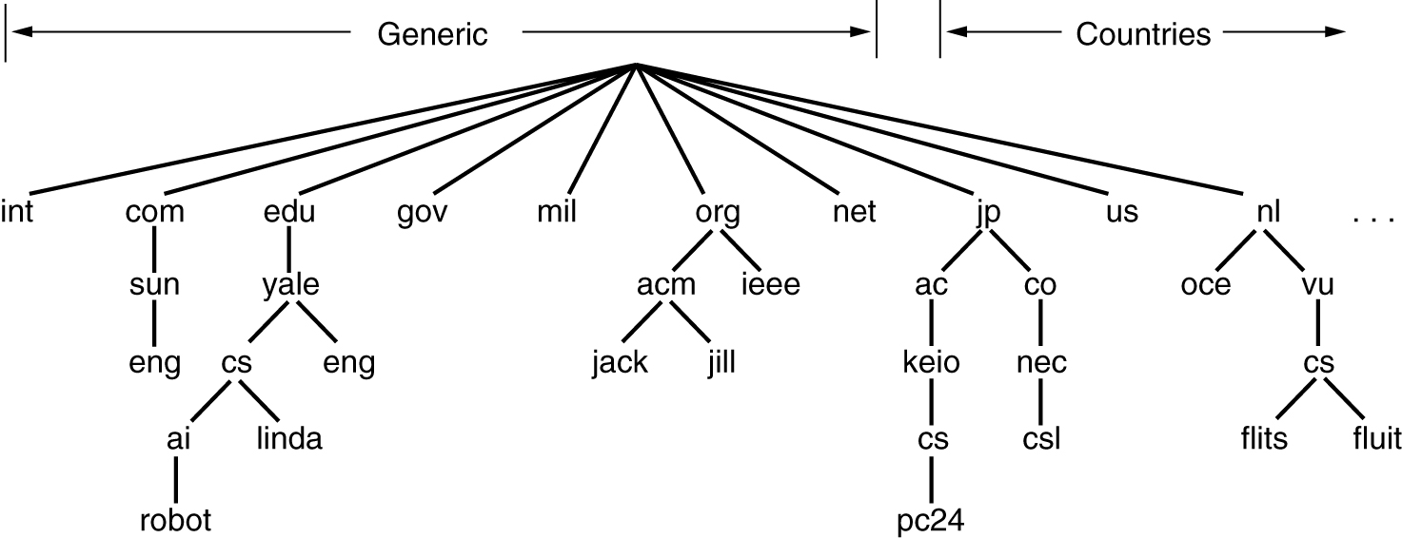
DNS Name Space (Top level Domain)
Internet is divided into over 200 top level domains
Each domain is divided into sub-domains, which are further partitioned, etc..
Top level domains could be generic and country domains

Slide 53
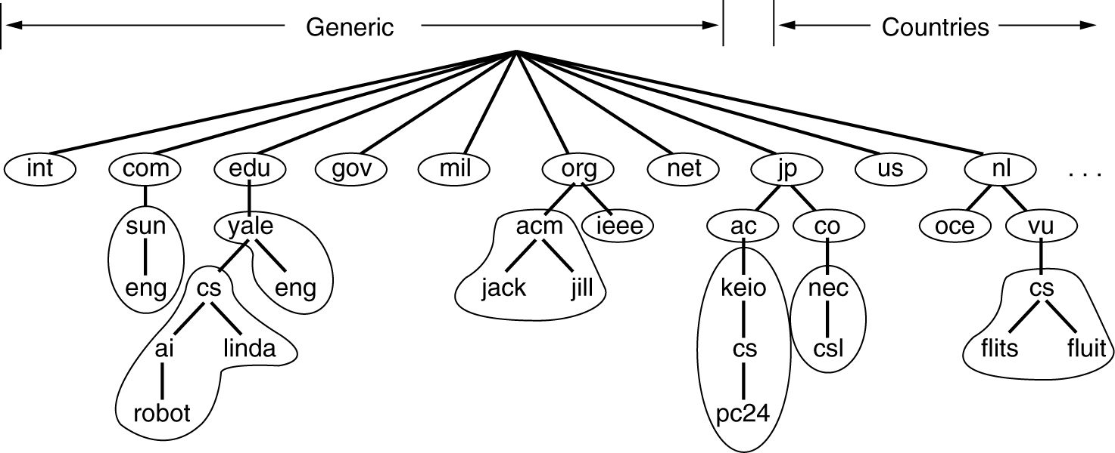
DNS Name servers
One DNS server could service all requests
But in practice it will be overloaded
To solve this, DNS name space is divided in non overlapping zones
Each zone contains some part of the tree and name servers holding zone info
Notes:
Where the zone boundaries are placed within a zone it is up to the zone’s administrator. This decision is made based on how many name servers are needed and where.
Example: Yale has a name server for yale.edu that handles eng.yale.edu but not cs.yale.edu, which is a separate zone with its own name servers. This decision can be made when a department such as Spanish didn’t want to run their own name server, but a department such as computer science did want to run its own DNS.

Slide 54
DNS Name Resolver
Query
Resolver
Name Server
Response
Resolver maps a name to an IP address and vice versa
There are 3 classes of DNS servers
Root DNS Server
Top-Level Domain(TLD) Server
Authoritative DNS Server

Slide 55
DNS Resolver (Types of Servers)
Root DNS Server
13 root DNS server
Top-Level Domain(TLD) Servers
Responsible for top level domains
Ex. Com,org,edu,gov and all country domains
Authoritative DNS Servers
Contains DNS record for every publically accessible organization on Internet
DNS record maps names to IP address
Labeled A to M

Slide 56
DNS Resolver ways
Resolving can be done in two ways
Iterative resolution
Recursive resolution

Slide 57
DNS name Iterative resolution example
root DNS server
2
Host at cis.poly.edu wants IP address for gaia.cs.umass.edu
3
TLD DNS server
(for edu)
4
5
iterated query:
contacted server replies with name of server to contact
“I don’t know this name, but ask this server”
local DNS server
dns.poly.edu
7
6
1
8
authoritative DNS server
dns.cs.umass.edu
requesting host
cis.poly.edu
gaia.cs.umass.edu

Slide 58
DNS name Recursive resolution example
root DNS server
recursive query:
puts burden of name resolution on contacted name server
heavy load?
2
3
7
6
TLD DNS server
local DNS server
dns.poly.edu
5
4
1
8
authoritative DNS server
dns.cs.umass.edu
requesting host
cis.poly.edu
gaia.cs.umass.edu

Slide 59
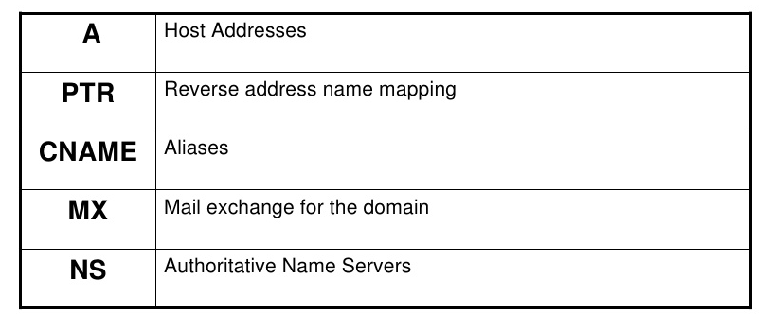
Resource Records
When a resolver gives a domain name to DNS, what it gets back are the resource records associated with that name;
Thus the primary function of DNS is to map domain names onto resource records
Types of Resource Record are as given in the table.

Slide 60
Parts Resource Records
Domain name
Time to Live
Class
Type
Value

Slide 61
Outline
Hyper Text Transfer Protocol (HTTP),
Email: SMTP, MIME, POP3, Webmail,
TELNET,
Dynamic Host Control Protocol (DHCP),
Simple Network Management Protocol (SNMP).
FTP,
Domain Name System (DNS),

Slide 62
TELNET vs. telnet
TELNET is a protocol that provides “a general, bi-directional, eight-bit byte oriented communications facility”.
telnet is a program that supports the TELNET protocol over TCP.
Many application protocols are built upon the TELNET protocol.

Slide 63
TELNET Protocol
TELNET is a general-purpose client-server application program.
TELNET is an abbreviation for TErminaL NETwork
Uses Port No 23 and TCP Protocol
Used for Virtual terminal service
TELNET enables the establishment of a connection to a remote system in such a way that the local terminal appears to be a terminal at the remote system.

Slide 64
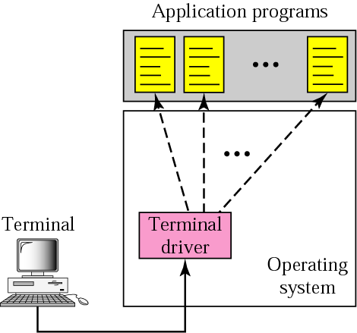
Local login

Slide 65
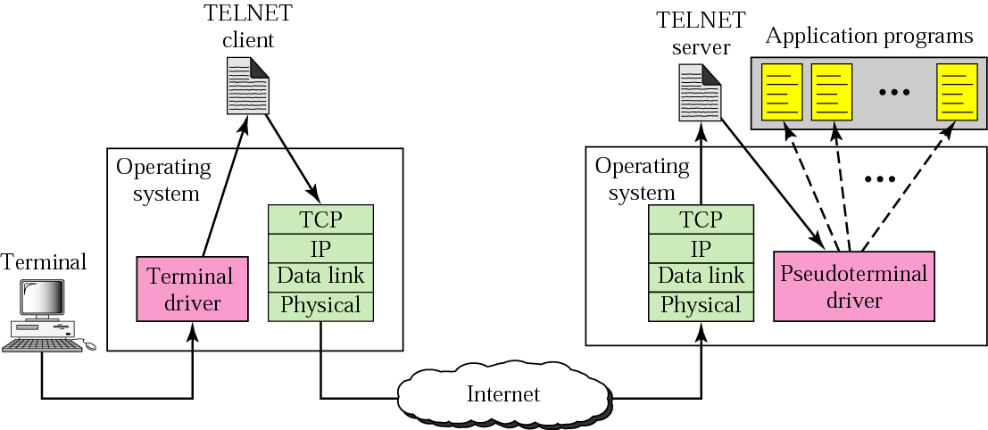
Remote login

Slide 66
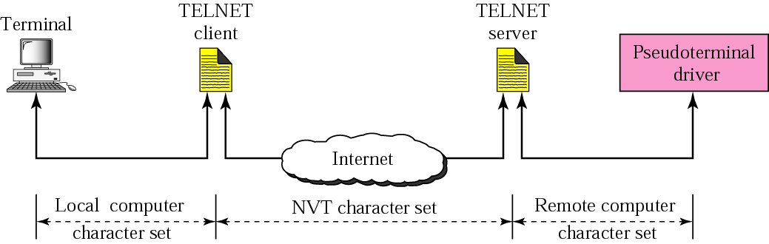
Concept of NVT

Slide 67
Network Virtual Terminal
Via a universal interface called the Network Virtual Terminal (NVT) character set, the TELNET client translates characters (data or commands) that come from the local terminal into NVT form and delivers them to the network. The TELNET server translates data and commands from NVT form into the form acceptable by the remote computer.

Slide 68
Network Virtual Terminal
intermediate representation of a generic terminal.
provides a standard language for communication of terminal control functions.
NVT uses two sets of characters, one for data(0) and other for control(1)

Slide 69
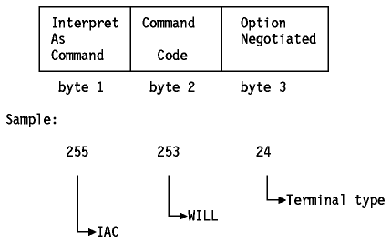
TELNET Command Structure

Slide 70
TELNET Basic Commands
AYT
Are you There
EC
Erase Character
AO
Abort Output
Quit Session
QUIT

Slide 71
Outline
Hyper Text Transfer Protocol (HTTP),
Email: SMTP, MIME, POP3, Webmail,
TELNET,
Dynamic Host Control Protocol (DHCP),
Simple Network Management Protocol (SNMP).
FTP,
Domain Name System (DNS),

Slide 72
Need of Dynamic Assignment of IP addresses
Need of Dynamic assignment of IP addresses
IP addresses are assigned on-demand
Avoid manual IP configuration
Support mobility of laptops
Support temporary allocation of IP addresses
Three Protocols:
RARP (until 1985, no longer used)
BOOTP (1985-1993)
DHCP (since 1993)
Only DHCP is widely used today.

Slide 73
DHCP
Designed in 1993
Uses UDP
An extension of BOOTP (Many similarities to BOOTP)
IP addresses are assigned dynamically on demand
Supports temporary allocation (“leases”) of IP addresses
DHCP client can acquire all IP configuration parameters
DHCP can interoperate with BOOTP clients.

Slide 74
DHCP Interaction (simplified)

Slide 75
BOOTP/DHCP Message Format
(There are >100 different options)

Slide 76
BOOTP/DHCP
OpCode: 1 (Request), 2(Reply)
Note: DHCP message type is sent in an option
Hardware Type: 1 (for Ethernet)
Hardware address length: 6 (for Ethernet)
Hop count: set to 0 by client
Transaction ID: Integer (used to match reply to response)
Seconds: number of seconds since the client started to boot
Client IP address, Your IP address, server IP address, Gateway IP address, client hardware address, server host name, boot file name: client fills in the information that it has, leaves rest blank

Slide 77
DHCP Message Type
Value | Message Type
1 | DHCPDISCOVER
2 | DHCPOFFER
3 | DHCPREQUEST
4 | DHCPDECLINE
5 | DHCPACK
6 | DHCPNAK
7 | DHCPRELEASE
8 | DHCPINFORM

Slide 78
DHCP Operation
DCHP DISCOVER
DCHP OFFER

Slide 79
DHCP Operation
DHCP RELEASE
At this time, the DHCP client has released the IP address

Slide 80
Outline
Hyper Text Transfer Protocol (HTTP),
Email: SMTP, MIME, POP3, Webmail,
TELNET,
Dynamic Host Control Protocol (DHCP),
Simple Network Management Protocol (SNMP).
FTP,
Domain Name System (DNS),

Slide 81
What is Network Management?
Basic tasks that fall under this category are:
Configuration Management
Keeping track of device settings and how they function
Fault Management
Dealing with problems and emergencies in the network (router stops routing, server loses power, etc.)
Performance Management
How smoothly is the network running?
Can it handle the workload it currently has?

Slide 82
Functional Areas of Network Management
Configuration Management - inventory, configuration, provisioning
Fault Management - reactive and proactive network fault management
Performance Management - # of packets dropped, timeouts, collisions, CRC errors
Security Management - SNMP doesn’t provide much here
Accounting Management - cost management and chargeback assessment
Asset Management - statistics of equipment, facility, and administration personnel
Planning Management - analysis of trends to help justify a network upgrade or bandwidth increase

Slide 83
What is SNMP?
SNMP that allows management of devices on the network like servers, workstations, routers, switches and other managed devices.
Comprised of agents and managers
Agent - process running on each managed node collecting information about the device it is running on.
Manager - process running on a management workstation that requests information about devices on the network.

Slide 84
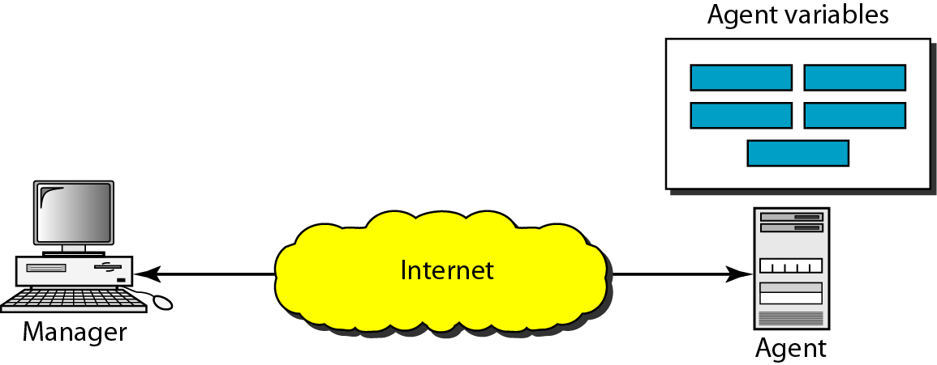
Figure 28.2 SNMP concept

Slide 85
Client Pull & Server Push
SNMP is a “client pull” model
The management system (client) “pulls” data from the agent (server).
SNMP is a “server push” model
The agent (server) “pushes” out a trap message to a (client) management system

Slide 86
Ports & UDP
SNMP uses User Datagram Protocol (UDP)
UDP Port 161 - SNMP Messages
UDP Port 162 - SNMP Trap Messages
CRC

Slide 87
The Three Parts of SNMP
SNMP network management is based on three parts:
SNMP Protocol
Defines format of messages exchanged by management systems and agents.
Specifies the Get, GetNext, Set, and Trap operations
Structure of Management Information (SMI)
Rules specifying the format used to define objects managed on the network that the SNMP protocol accesses
Management Information Base (MIB)
List of objects and how they are accessed

Slide 88
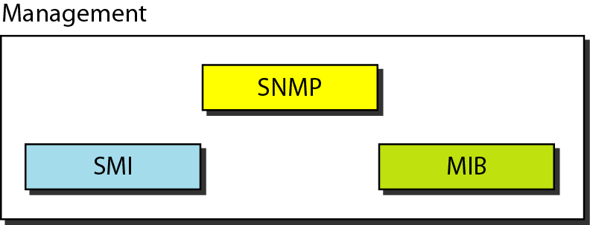
Figure Components of network management on the Internet

Slide 89
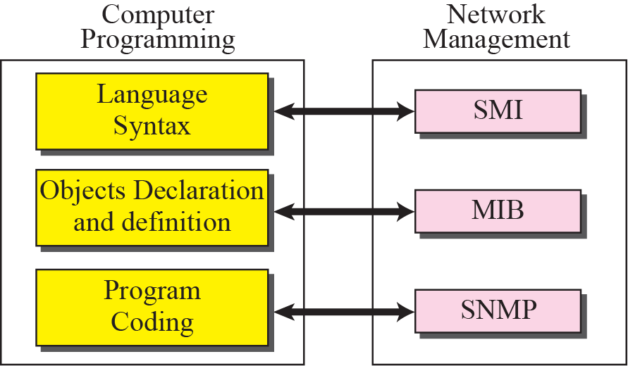
Figure Comparing computer programming and network management

Slide 90
Four Basic Operations
Get
Retrieves the value of a MIB variable stored on the agent machine
(integer, string, or address of another MIB variable)
GetNext
Retrieves the next value of the next lexical MIB variable
Set
Changes the value of a MIB variable
Trap
typically a notification of something unexpected, like an error

Slide 91
Languages of SNMP
Structure of Management Information (SMI)
specifies the format used for defining managed objects that are accessed via the SNMP protocol
Abstract Syntax Notation One (ASN.1)
used to define the format of SNMP messages and managed objects (MIB modules) using an unambiguous data description format
Basic Encoding Rules (BER)
used to encode the SNMP messages into a format suitable for transmission across a network

Slide 92
SNMP Data Types
INTEGER -- signed 32-bit integer
OCTET STRING
OBJECT IDENTIFIER (OID)
NULL -- not actually data type, but data value
IpAddress -- OCTET STRING of size 4, in network byte order (B.E.)
Counter -- unsigned 32-bit integer (rolls over)
Gauge -- unsigned 32-bit integer (will top out and stay there)
TimeTicks -- unsigned 32-bit integer (rolls over after 497 days)
Opaque -- used to create new data types not in SNMPv1
DateAndTime, DisplayString, MacAddress, PhysAddress, TimeInterval, TimeStamp, TruthValue, VariablePointer -- textual conventions used as types

Slide 93
Basic Message Format
Message Length
Message Version
Message Preamble
Community String
PDU Header
SNMP Protocol Data Unit
PDU Body

Slide 94
Commercial SNMP Applications
Here are some of the various SNMP Management products available today:
http://www.hp.com/go/openview/ HP OpenView
http://www.tivoli.com/ IBM NetView
http://www.novell.com/products/managewise/ Novell ManageWise
http://www.sun.com/solstice/ Sun MicroSystems Solstice
http://www.microsoft.com/smsmgmt/ Microsoft SMS Server
http://www.compaq.com/products/servers/management/ Compaq Insight Manger
http://www.redpt.com/ SnmpQL - ODBC Compliant
http://www.empiretech.com/ Empire Technologies
ftp://ftp.cinco.com/users/cinco/demo/ Cinco Networks NetXray
http://www.netinst.com/html/snmp.html SNMP Collector (Win9X/NT)
http://www.netinst.com/html/Observer.html Observer
http://www.gordian.com/products_technologies/snmp.html Gordian’s SNMP Agent
http://www.castlerock.com/ Castle Rock Computing
http://www.adventnet.com/ Advent Network Management
http://www.smplsft.com/ SimpleAgent, SimpleTester

Slide 95
References
http://highered.mheducation.com/sites/0072460601/student_view0/
www.wtcs.org/snmp4tpc/files/reference/francois/snmp.ppt
ece626web.groups.et.byu.net/Lectures/ch26.ppt
https://www.slideshare.net/MaiyurHossain/http-48129051

